Slide 1
Introduction to Deep Learning
Neural Network
主讲人：傅启明

Slide 2

what is AI？
AI is the new Electricity
Electricity had once transformed countless industries: transportation, manufacturing, healthcare, communications, and more
AI will now bring about an equally big transformation.

Slide 3
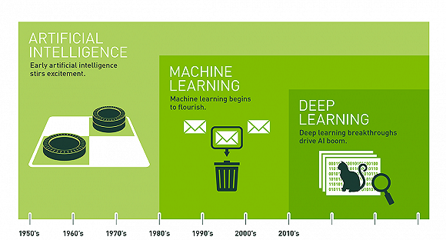
AI，Machine Learning，Deep Learning

Slide 4
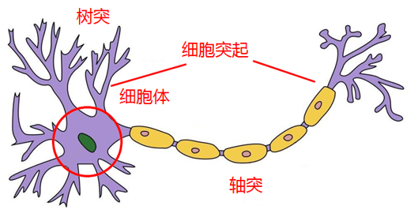
Housing Price Prediction
x
x
x
price
x
x
size
neuron
price
x
x
size of house

Slide 5
Housing Price Prediction
size
neuron
size

Slide 6
Housing Price Prediction
size
x₁
#bedrooms
x₂
y
zip code
x₃
wealth
x₄

Slide 7
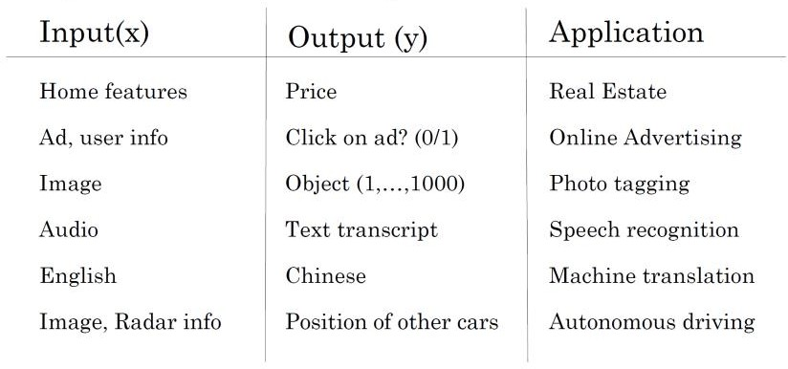
Supervised learning for Neural Network

Slide 8
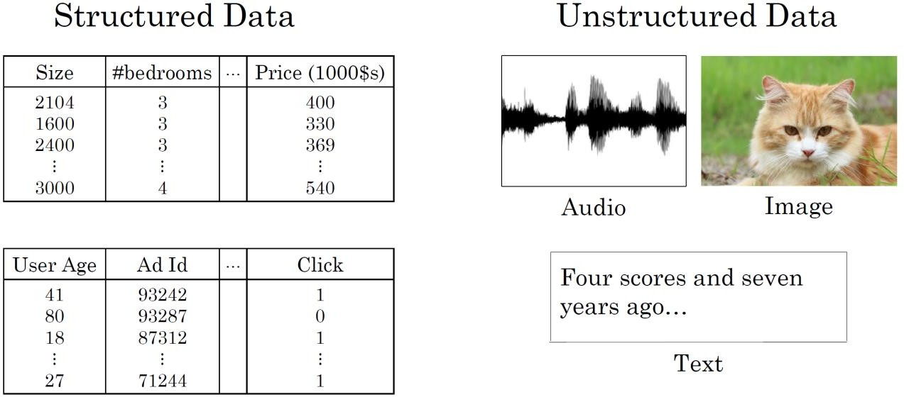
Supervised learning for Neural Network
Structured and Unstructured Data

Slide 9
Supervised learning for Neural Network
Structured and Unstructured Data

Slide 10
Why is deep learning taking off?
Scale driving deep learning process
performance
Amount of Data
Deep learning is taking off due to a large amount of data available through the digitization of the society, faster computation and innovation in the development of neural network algorithm

Slide 11
Neural Network
Basics of Neural Network Programming

Slide 12

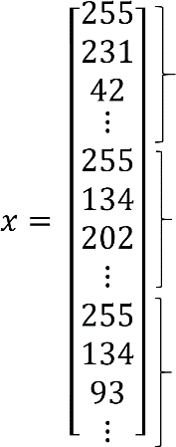
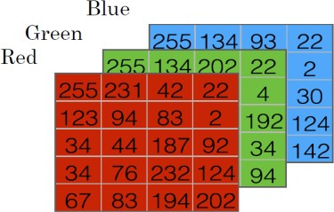
Binary Classification
64
1 (cat) vs 0 (non cat)
64
red
green
blue

Slide 13
Notation
Sample
Training sample Set and Test Sample Set
Matrix of Samples

Slide 14
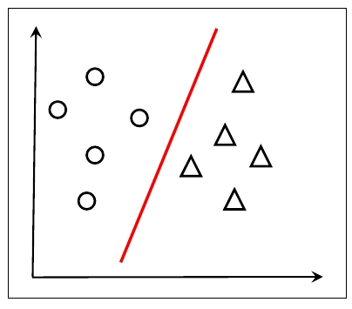
Logistics Regression
Classification problem
Notes:
给出问题的定义，给出logistics模型
给出sigmod函数的介绍
给出向量表示方式，w和b分开表示，以及合并表示

Slide 15


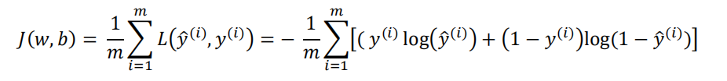
Logistic Regression：cost function
Loss function：
Cost function：
Notes:
给出loss function的直观解释，以y为1和0分别举例。

Slide 16
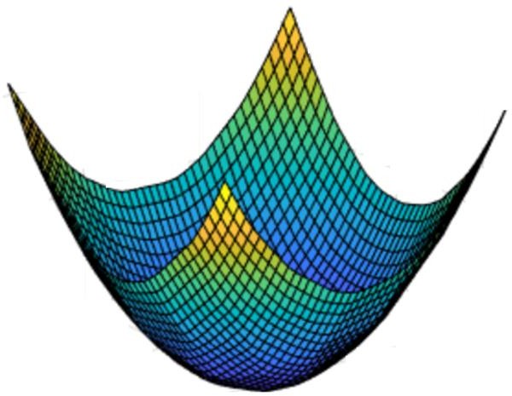
Gradient Descent
Notes:
给出w的更新公式 w= w -\alpha * dJ(w)/dw,并给出\alpha的含义介绍。给出形象化的介绍。

Slide 17
Computation Graph
example：
J(a,b,c) = 3(a+bc)
Notes:
给出计算图的展开说明

Slide 18
Computation Graph：Derivatives with a Computation Graph
J(a,b,c) = 3(a+bc)
𝑎 = 5
𝑏 = 3
𝑐 = 2
𝑣 = 𝑎 + 𝑢
𝐽 = 3𝑣
𝑢=b𝑐
Notes:
给出具体的导数计算

Slide 19
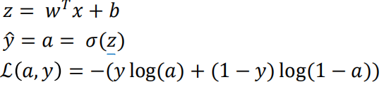
Logistic regression recap

Slide 20
Logistic regression derivatives
x₁
x₂
w₁
w₂
b
z=w₁x₁ + w₂x₂ + 𝑏
a = σ(z)
ℒ(a, 𝑦)
Notes:
给出推导

Slide 21
Logistic regression on m examples
J=0;dw1=0;dw2=0;db=0;
for i = 1 to m
z(i) = w^{T}x(i)+b;
a(i) = sigmoid(z(i));
J += -[y(i)log(a(i))+(1-y(i)）log(1-a(i));
dz(i) = a(i)-y(i);
dw1 += x1(i)dz(i);
dw2 += x2(i)dz(i);
db += dz(i);
J/= m;
dw1/= m;
dw2/= m;
db/= m;
w=w-alpha*dw
b=b-alpha*db

Slide 22
Neural network programming guideline
Whenever possible, avoid explicit for-loops.
vectorization method

Slide 23
Neural network programming guideline
J=0;dw1=0;dw2=0;db=0;
for i = 1 to m
z(i) = w^{T}x(i)+b;
a(i) = sigmoid(z(i));
J += -[y(i)log(a(i))+(1-y(i)）log(1-a(i));
dz(i) = a(i)-y(i);
dw1 += x1(i)dz(i);
dw2 += x2(i)dz(i);
db += dz(i);
J/= m;
dw1/= m;
dw2/= m;
db/= m;
w=w-alpha*dw
b=b-alpha*db
J=0;dw= np.zeros(nx,1) ;db=0;
for i = 1 to m
z(i) = wx(i)+b;
a(i) = sigmoid(z(i));
J += -[y(i)log(a(i))+(1-y(i)）log(1-a(i));
dz(i) = a(i)-y(i);
dw += x(i)dz(i);
db += dz(i);
J/= m;
dw/= m;
db/= m;
w=w-alpha*dw
b=b-alpha*db
Notes:
修改下面dw的地方，改为向量的处理方法

Slide 24
Vectorizing Logistic Regression
_{𝑧}(1) _{= 𝑤}𝑇_{𝑥}(1) _{+ 𝑏}
_{𝑎}(1) _{= 𝜎(𝑧}(1)₎
_{𝑧}(3) _{= 𝑤}𝑇_{𝑥}(3) _{+ 𝑏}
_{𝑧}(2) _{= 𝑤}𝑇_{𝑥}(2) _{+ 𝑏}
_{𝑎}(2) _{= 𝜎(𝑧}(2)₎
_{𝑎}(3) _{= 𝜎(𝑧}(3)₎

Slide 25
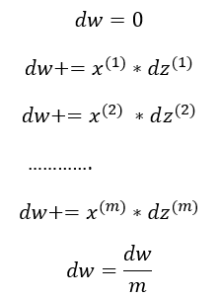
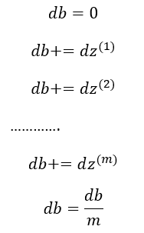







Vectorizing Logistic Regression
$$dz^{\left(1\right)}=a^{\left(1\right)}−y^{\left(1\right)}$$
$$dz^{\left(2\right)}=a^{\left(2\right)}−y^{\left(2\right)}$$
$$\left.dZ=[dz^{\left(1\right)},dz^{\left(2\right)}...dz^{\left(m\right)}\right]$$
$$\left.dZ=A−Y=[a^{\left(1\right)}−y^{\left(1\right)}{,a}^{\left(2\right)}−y^{\left(2\right)}...a^{\left(m\right)}−y^{\left(m\right)}\right]$$
$$db=\frac{1}{m}\sum_{i=1}^{m}{d}z^{\left(i\right)}$$
$$db=\frac{1}{m}∗np.sum\left(dZ\right)$$
$$dw=\frac{1}{m}∗X∗dz^{T}$$
$$\left.dw=\frac{1}{m}∗(x^{\left(1\right)}dz^{\left(1\right)}+x^{\left(2\right)}dz^{\left(2\right)}+...+x^{m}dz^{m}\right)$$

Slide 26
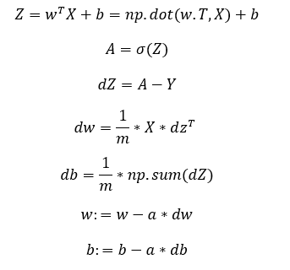
Vectorizing Logistic Regression
J=0;dw= np.zeros(nx,1) ;db=0;
for i = 1 to m
z(i) = wx(i)+b;
a(i) = sigmoid(z(i));
J += -[y(i)log(a(i))+(1-y(i)）log(1-a(i));
dz(i) = a(i)-y(i);
dw += x(i)dz(i);
db += dz(i);
J/= m;
dw/= m;
db/= m;
w=w-alpha*dw
b=b-alpha*db

